Slide 1
CSCI 631 Foundations of Computer Vision
Ifeoma Nwogu
ion@cs.rit.edu
Lecture 8 - Classifiers

Slide 2
Schedule
Last class
Segmentation and clustering
Today
Start classifiers
Readings (optional):
Forsyth and Ponce chapter 15;

Slide 3
Classifiers
Given a feature representation for images, how do we learn a model for distinguishing features from different classes?
Take a measurement x, predict a bit
binary classifiers: (yes/no; 1/-1; 1/0; etc.)
Today:
Nearest neighbor classifiers
Linear classifiers: support vector machines
Other techniques:
Logistic regression, Boosting, Decision trees and forests, Deep neural networks

Slide 4
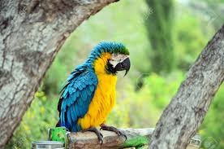
Image classification
The big problems
Image classification
e.g. this picture contains a parrot
Object detection
e.g. in this box in the picture is a parrot
Strategy
Generate features from image (there are many quite complex strategies)
Put in one or more classifiers

Slide 5
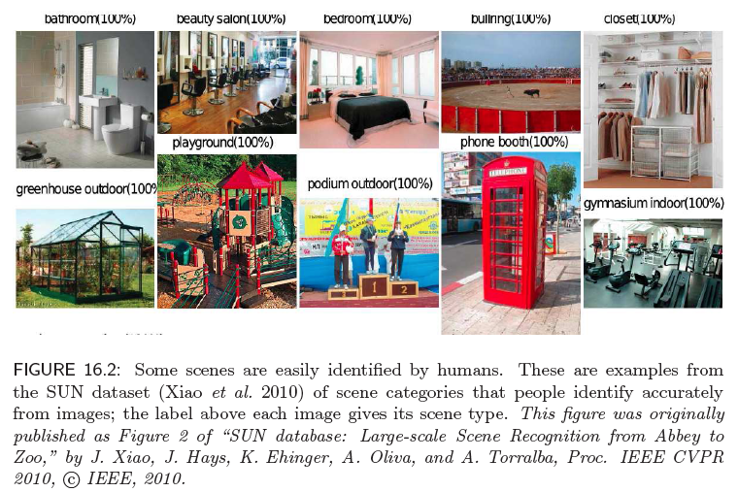
Image classification - scenes

Slide 6
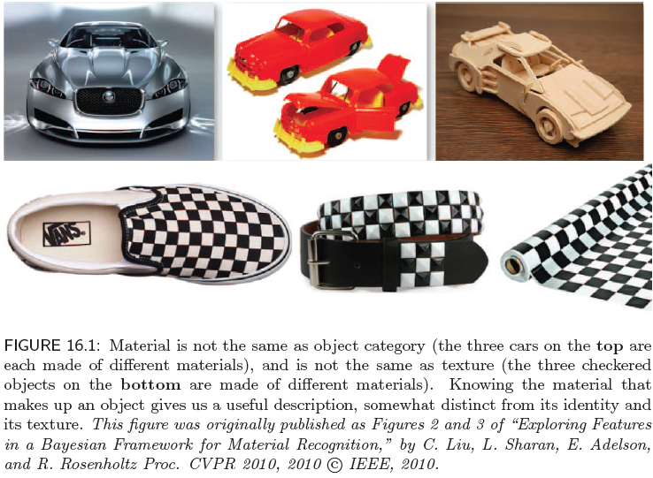
Image classification - material

Slide 7
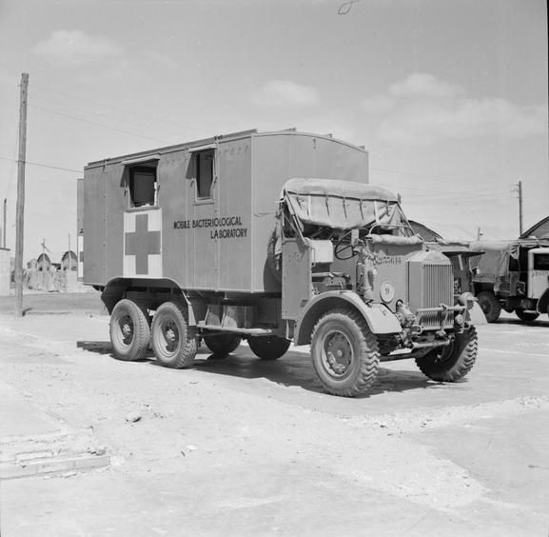
Troubleshooting
Trained images of truck outdoors at multiple poses and scales
Training yielded almost zero error
Testing yielded almost 50% error!
Possible reasons for failure?

Slide 8
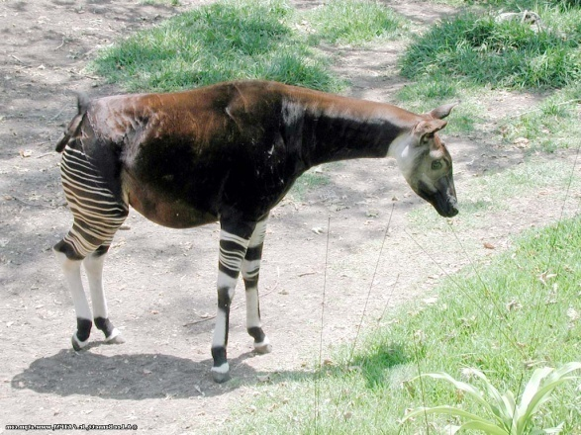
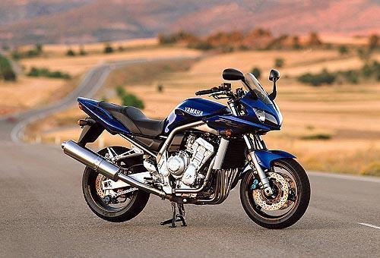
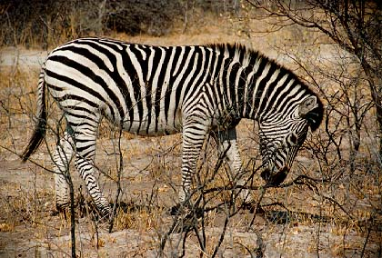
Classifiers
Given a feature representation for images, how do we learn a model for distinguishing features from different classes?
Decision boundary
Zebra
Non-zebra

Slide 9
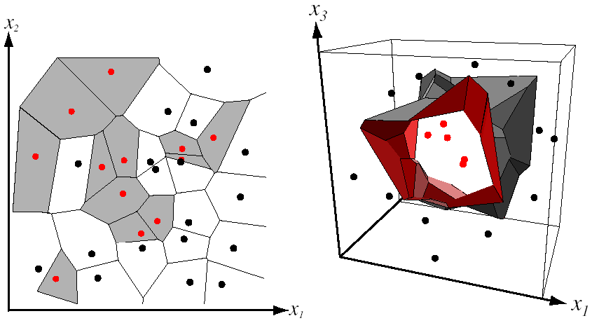
Nearest Neighbor Classifier
Assign label of nearest training data point to each test data point
from Duda et al.

Slide 10
Classifiers
Take a measurement x, predict a bit (yes/no; 1/-1; 1/0; etc)
Strategies:
non-parametric
nearest neighbor
probabilistic
histogram
logistic regression
decision boundary
SVM

Slide 11
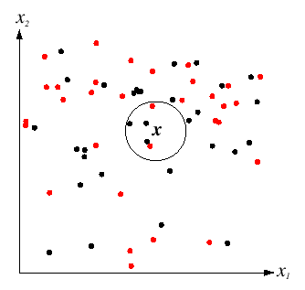
K-Nearest Neighbors
For a new point, find the k closest points from training data
Labels of the k points “vote” to classify
k = 5

Slide 12
Histogram based classifiers
Represent class-conditional densities with histogram
Advantage:
estimates become quite good
(with enough data!)
Disadvantage:
Histogram becomes big with high dimension
but maybe we can assume feature independence?

Slide 13
Histogram classifier for scene recognition
When is scene identification just texture recognition?
Paper by Laura Renninger and Jitendra Malik (Journal of Vision, 2004)

Slide 14
Distance functions for bags of features
Euclidean distance:
L1 distance:
χ² distance:
Histogram intersection (similarity):
Hellinger kernel (similarity):

Slide 15
Curse of dimension
Hard to build a histogram based classifier for when feature space is high-dimensional
try R, G, B, and some texture features
Fails when there are too many histogram buckets
Walk-around
Build prototypes from training images as shown in texture recognition example

Slide 16
Linear classifiers
Find linear function (hyperplane) to separate positive and negative examples
Which hyperplane is best?

Slide 17
Support vector machines
Find hyperplane that maximizes the margin between the positive and negative examples
For support vectors,
Distance between point and hyperplane:
Therefore, the margin is 2 / ||w||
Support vectors
Margin
C. Burges, A Tutorial on Support Vector Machines for Pattern Recognition, Data Mining and Knowledge Discovery, 1998

Slide 18
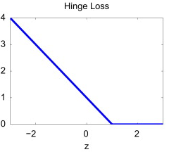
What if the data is not linearly separable?
+1
Margin
0
-1
Demo: http://cs.stanford.edu/people/karpathy/svmjs/demo

Slide 19
Nonlinear SVMs
Datasets that are linearly separable work out great:
But what if the dataset is just too hard?
We can map it to a higher-dimensional space:
0
x
0
x
x²
0
x
Slide credit: Andrew Moore

Slide 20
Nonlinear SVMs
General idea: the original input space can always be mapped to some higher-dimensional feature space where the training set is separable:
Φ: x → φ(x)
Slide credit: Andrew Moore

Slide 21
Nonlinear SVMs
The kernel trick: instead of explicitly computing the lifting transformation φ(x), define a kernel function K such that K(x , y) = φ(x) · φ(y)
This gives a nonlinear decision boundary in the original feature space:
C. Burges, A Tutorial on Support Vector Machines for Pattern Recognition, Data Mining and Knowledge Discovery, 1998

Slide 22
Nonlinear kernel: Example
Consider the mapping
x²
Excuse the abuse of notation
The kernel function computes the inner-product between two projected vectors

Slide 23
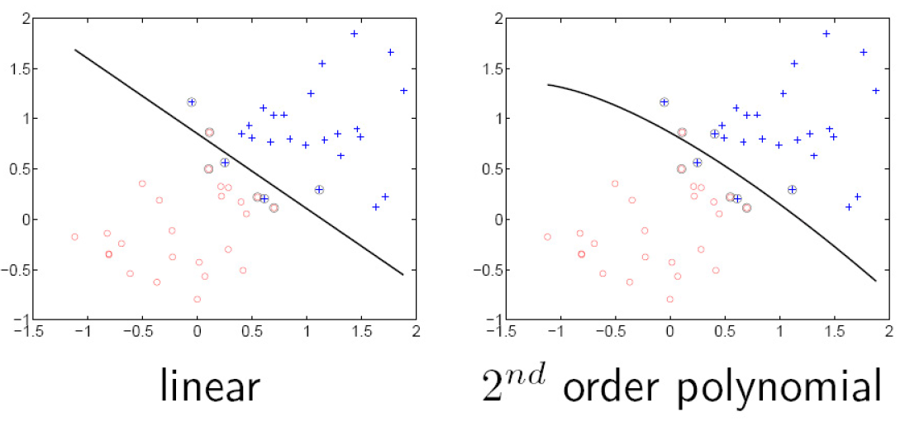
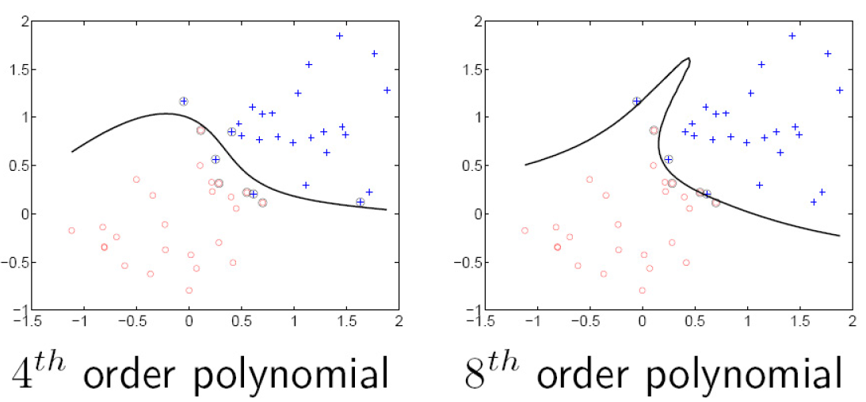
Polynomial kernel:

Slide 24
Gaussian kernel
Also known as the radial basis function (RBF) kernel:
The corresponding mapping φ(x) is infinite-dimensional!

Slide 25
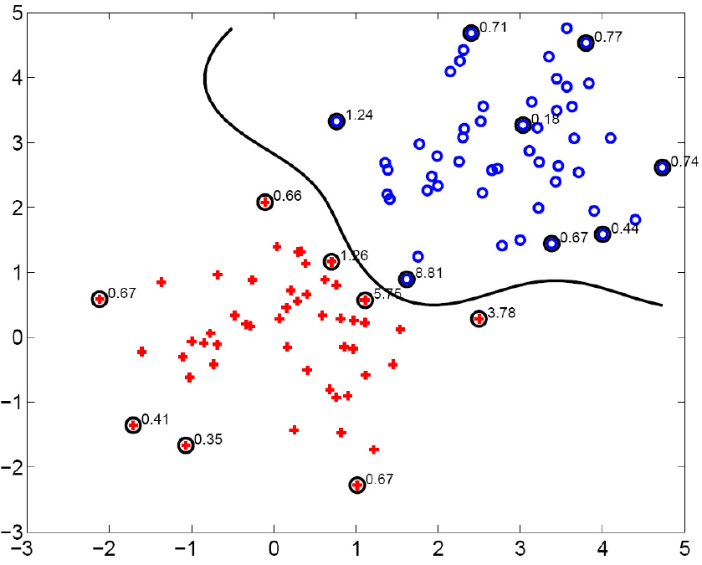
Gaussian kernel
SV’s

Slide 26
Why use kernels ?
Classifiers can be learnt for high dimensional features spaces
the points need not necessarily be mapped into the high dimensional space.
Data may be linearly separable in the high dimensional space
the points need not be linearly separable in the original feature space

Slide 27
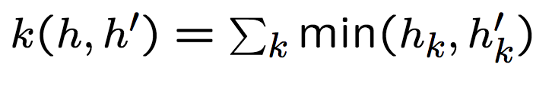
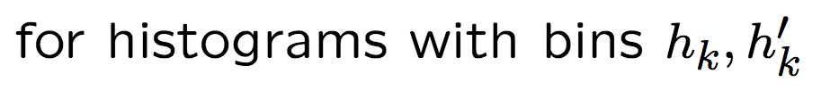
Why use kernels ? cont’d
Kernels can be used for an SVM because of the scalar product in the dual form
Kernels can also be used elsewhere – they are not tied to the SVM formalism
Kernels apply also to objects that are not vectors, e.g.

Slide 28
Summary: SVMs for image classification
Pick an image representation
Pick a kernel function for that representation
Compute the matrix of kernel values between every pair of training examples
Feed the kernel matrix into your favorite SVM solver to obtain support vectors and weights
At test time: compute kernel values for your test example and each support vector, and combine them with the learned weights to get the value of the decision function

Slide 29
What about multi-class SVMs?
Unfortunately, there is no “definitive” multi-class SVM formulation
In practice, we have to obtain a multi-class SVM by combining multiple two-class SVMs
One vs. others
Training: learn an SVM for each class vs. the others
Testing: apply each SVM to test example and assign to it the class of the SVM that returns the highest decision value
One vs. one
Training: learn an SVM for each pair of classes
Testing: each learned SVM “votes” for a class to assign to the test example

Slide 30
SVMs: Pros and cons
Pros
Many publicly available SVM packages: http://www.kernel-machines.org/software
Kernel-based framework is very powerful, flexible
SVMs work very well in practice, even with very small training sample sizes
Faster in training, fewer support vectors
Cons
No “direct” multi-class SVM, must combine two-class SVMs
Computation, memory
During training time, must compute matrix of kernel values for every pair of examples
Learning can take a very long time for large-scale problems

Slide 31
SVMs for large-scale datasets
Efficient linear solvers
LIBLINEAR, PEGASOS
Explicit approximate embeddings: define an explicit mapping φ(x) such that φ(x) · φ(y) approximates K(x , y) and train a linear SVM on top of that embedding
Random Fourier features for the Gaussian kernel (Rahimi and Recht, 2007)
Embeddings for additive kernels, e.g., histogram intersection (Maji et al., 2013, Vedaldi and Zisserman, 2012)

Slide 32
Slide Credits
Svetlana Lazebnik – UIUC
David Forsyth - UIUC

Slide 33

Questions

